Slide 1
Azure devops Projects
OW

Slide 2
Overview
Azure Boards offers various processes to choose from for managing work items. Selecting the right process is essential for optimizing a project workflow and ensuring its success.
How to choose the most suitable process for your project.?
When you create a project, you choose a process or process template based on the process model for which your organization or collection was created.

Slide 3
Processes
The default processes differ mainly in the work item types they provide for planning and tracking work. The default processes are:
Basic: Is the most lightweight and is in a selective preview.
Scrum: Is the next most lightweight.
Agile: Supports many Agile method terms.
CMMI: Provides the most support for formal processes and change management.

Slide 4
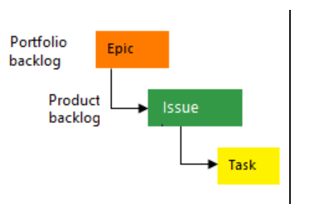
Basic
Choose Basic when your team wants the simplest model that uses Issue, Task, and Epic work item types to track work.

Slide 5
Agile
Agile Team: Your team follows Agile principles, which emphasize flexibility and collaboration. This includes roles like Scrum Master and Product Owner, similar to Scrum.
User Stories: Instead of detailed requirements, you have user stories that describe what a user needs from the product. These are like small, manageable tasks.
Iterations: Agile works in short iterations, similar to sprints in Scrum. Each iteration typically lasts 1-4 weeks.
Kanban Board: You use a Kanban board to track progress visually. You can organize tasks, user stories, and bugs into columns like "To Do," "Doing," and "Done."

Slide 6
..
Development and Test Activities: Unlike Scrum, Agile often tracks development and test activities separately. This means you may have separate columns or boards for development tasks and testing tasks.
Taskboard: In addition to the Kanban board, you can use a taskboard to track individual tasks within user stories or bugs. This helps break down work into smaller steps.
Continuous Delivery: Agile emphasizes delivering working software frequently. Each iteration should result in a potentially shippable product increment.
Feedback and Adaptation: Agile teams value feedback and adapt their plans based on it. This could include feedback from customers, stakeholders, or team members.

Slide 7
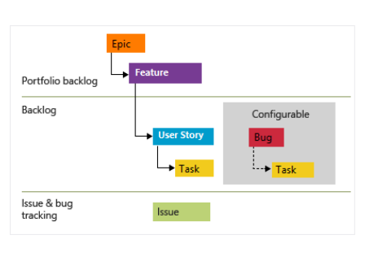
Agile

Slide 8
CMMI
Formal Project Methods: CMMI is for teams that follow structured and formal project management methods. It's about having clear processes and procedures in place.
Process Improvement Framework: CMMI provides a framework for improving processes within your team or organization. It helps you assess and improve how you do things.
Auditable Record: CMMI emphasizes maintaining detailed records of decisions, actions, and processes. This helps with auditing and ensuring accountability.
Tracking Requirements: You can use CMMI to track requirements for your project. This includes gathering, documenting, and managing requirements throughout the project lifecycle.

Slide 9
..
Change Requests: CMMI helps manage change requests effectively. It involves documenting and assessing proposed changes, determining their impact, and implementing them if approved.
Risk Management: CMMI includes processes for identifying, analyzing, and managing risks. This involves assessing potential risks, developing mitigation strategies, and monitoring risks throughout the project.
Reviews: CMMI supports conducting formal reviews and evaluations of project artifacts, processes, and outcomes. This could include peer reviews, management reviews, or customer reviews.

Slide 10



